Slide 1
ESc201 : Introduction to Electronics
Digital Circuits: Multiplexer
Vipul Arora
Dept. of Electrical Engineering
IIT Kanpur
April 6, 2022

Slide 2
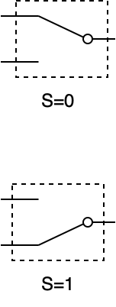

Multiplexer (switch)
$$y=\overline{S}I_{0}+SI_{1}$$
Can you implement is using AND, OR, NOT gates?
I₀
1
I₀
0
0
0
Can you implement is using NAND gates?

Slide 4
Implementing Boolean expressions using Multiplexers
x₂
?
x₂
?
0
0
0
y = x₂ when x₁ = 0
0
1
1
1
0
1
y = x₂ when x₁ = 1
1
1
0

Slide 5
A 3 variable function can be implemented with a 4:1 mux with 2 select lines
0
0
0 0
0 0
0
F = 0 when yz = 00
x
1
0
1
0
0 1
0 1
1
F = x when yz =01
x
1
0
0
1 0
1 0
1
y
z
F = 1 when yz = 10
1
1
0
1 1
1 1
0
F = x when yz = 11
1
1

Slide 6
Mux. expansion
1
0
I₁
I₁
0
1
0

Slide 7
Mux. expansion
0
1
I₃
0
I₃
1
1

Slide 8
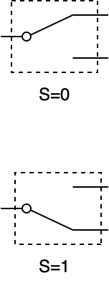
DeMultiplexer
S₁ | S₀ | y₀ | y₁ | y₂ | y₃
0 | 0 | D | 0 | 0 | 0
0 | 1 | 0 | D | 0 | 0
1 | 0 | 0 | 0 | D | 0
1 | 1 | 0 | 0 | 0 | D

Slide 9
Summary
Mux: selects input channel; single output
Demux: single input; selects output channel

Slide 10
Demultiplexer is very much like a decoder
D | S₁ | S₀ | y₀ | y₁ | y₂ | y₃
0 | x | x | 0 | 0 | 0 | 0
1 | 0 | 0 | 1 | 0 | 0 | 0
1 | 0 | 1 | 0 | 1 | 0 | 0
1 | 1 | 0 | 0 | 0 | 1 | 0
1 | 1 | 1 | 0 | 0 | 0 | 1
S₁ | S₀ | y₀ | y₁ | y₂ | y₃
0 | 0 | D | 0 | 0 | 0
0 | 1 | 0 | D | 0 | 0
1 | 0 | 0 | 0 | D | 0
1 | 1 | 0 | 0 | 0 | D
Data
1
1
0
0
0
0
0

